Slide 1

Exploring the Boston housing Dataset
By Janmaya Kumar Jena

Slide 2

Contents :
Data Understanding
Columns understanding
Objective
Insights and observation
Conclusion

Slide 3

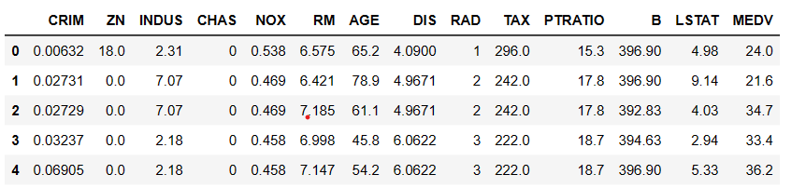
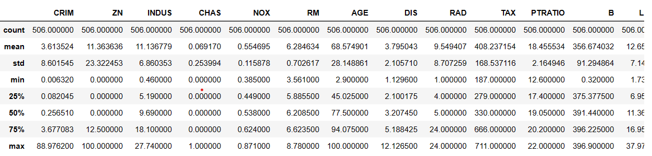
Data Understanding :
No of rows
506
No of column
14
Statistical understanding :

Slide 4
Column explanation for the Boston Housing dataset:
CRIM: Per capita crime rate by town
ZN: Proportion of residential land zoned for lots over 25,000 sq. ft.
INDUS: Proportion of non-retail business acres per town
CHAS: Charles River dummy variable (1 if tract bounds river; 0 otherwise)
NOX: Nitric oxides concentration (parts per 10 million)
RM: Average number of rooms per dwelling
AGE: Proportion of owner-occupied units built prior to 1940
DIS: Weighted distances to five Boston employment centers
RAD: Index of accessibility to radial highways
TAX: Full-value property tax rate per $10,000
PTRATIO: Pupil-teacher ratio by town
B: 1000(Bk - 0.63)^2 where Bk is the proportion of Black individuals by town
LSTAT: Percentage of the lower status of the population
MEDV: Median value of owner-occupied homes in $1000s

Slide 5

Objectives :
Find the percentage of outliers in the dataset.
Find the relationship between all the columns by creating a heatmap.
How does the variable CRIM affect the median value of the houses?
Identify any differences that occur in houses located near the CHAS River compared to those that are not.
Examine the relationship between the age of the houses and the median value (MEDV).
Investigate the relationship between the RAD variable and the median value (MEDV).
Analyze the impact of pollution on the median value.
Explore the relationship between the TAX variable and the median value (MEDV).
Examine the relationship between the number of rooms and the median value (MEDV).

Slide 6
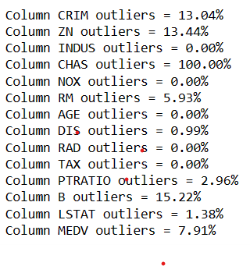
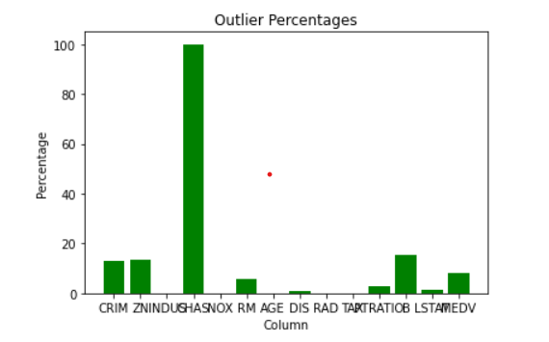
Find the percentage of outliers in the dataset :
The CRIM, ZN, and B columns have more than 13% outliers, while other columns show a lower percentage. However, the CHAS variable, being a binary variable, is not appropriate to consider zero values as outliers, thus making the percentage of outliers in CHAS not meaningful for analysis.

Slide 7
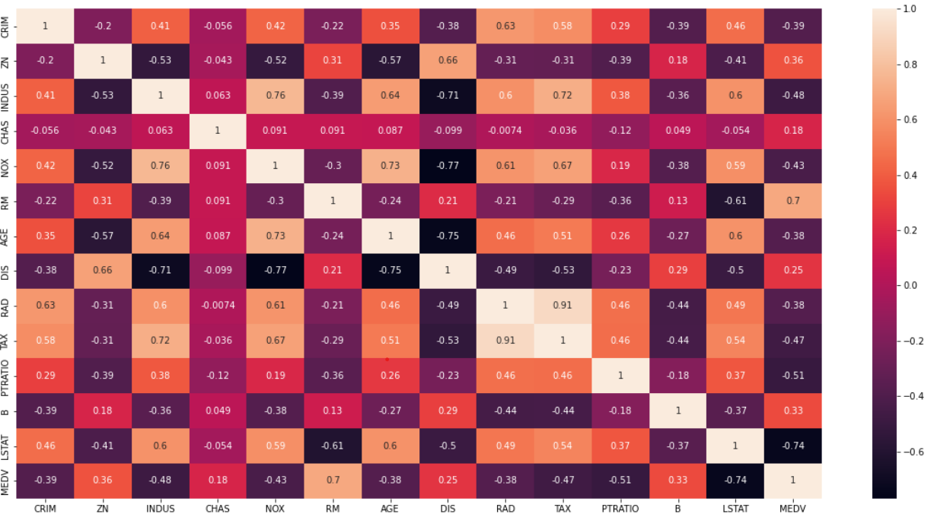
Find the relationship between all the columns :
The heatmap reveals positive correlations between variables, indicating that when one variable increases, the other variable tends to increase as well, and vice versa. The intensity of color on the heatmap signifies the strength of the positive correlation, with darker colors indicating stronger correlations. Positive correlations are valuable for predicting one variable's value based on another variable's value.

Slide 8

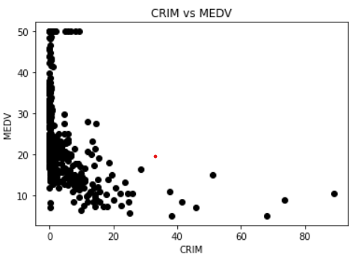
How does the variable CRIM affect the median value of the houses :
The scatter plot of CRIM (crime rate) against MEDV (home value) reveals a negative correlation, indicating that higher crime rates are associated with lower home values. The correlation coefficient confirms this negative relationship.

Slide 9

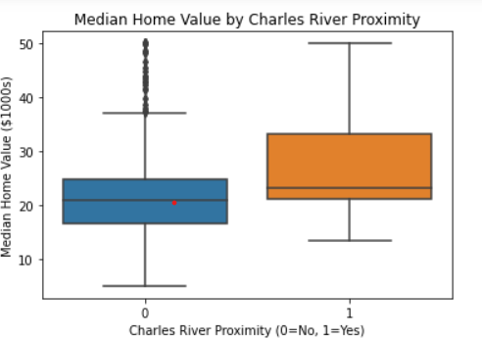
Identify any differences that occur in houses located near the CHAS River compared to those that are not.
The box plot demonstrates that houses near the Charles River have higher median home values compared to those farther away. Factors like scenic location and amenities may contribute to this difference. It's important to note that the plot only shows median values, and there may be considerable variation within each group.

Slide 10
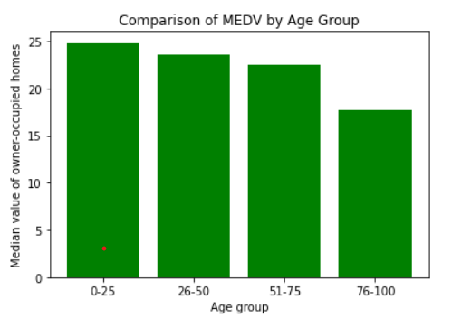

Examine the relationship between the age of the houses and the median value (MEDV).
The bar plot reveals a clear trend: as house age increases, the median value of owner-occupied homes tends to decrease. The age group of 0-25 exhibits the highest median value, indicating that newer houses have higher values. Conversely, the age group of 76-100 has the lowest median value, suggesting that very old houses tend to have lower values.

Slide 11

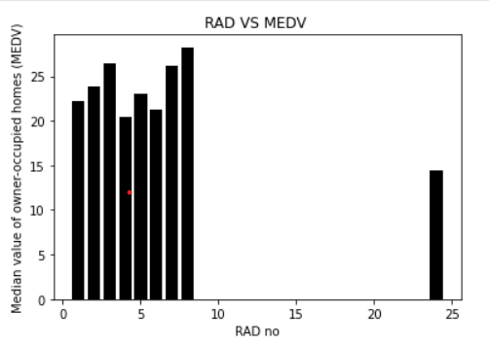
Investigate the relationship between the RAD variable and the median value (MEDV).
The bar chart displays the relationship between the accessibility index to radial highways (RAD) and the median value of owner-occupied homes (MEDV). It reveals that a higher RAD index, indicating better accessibility, corresponds to higher median home values, while a lower RAD index corresponds to lower median values. This suggests a positive impact of highway accessibility on home values in the Boston Housing Dataset.

Slide 12
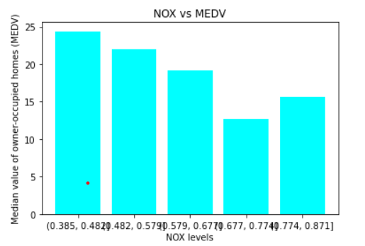

Analyze the impact of pollution on the median value :
From the plot, we can see that as the NOX levels increase, the median value of owner-occupied homes decreases. This suggests that higher levels of NOX pollution in the air may have a negative impact on the value of homes in the area.

Slide 13

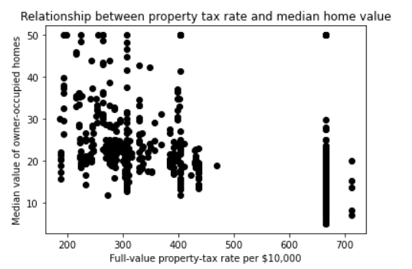
Explore the relationship between the TAX variable and the median value (MEDV).
The scatter plot demonstrates a negative correlation between the full-value property-tax rate and the median value of owner-occupied homes. As the property-tax rate rises, the median home value generally decreases. However, there are some outliers where high property-tax rates are associated with high median home values. This suggests that property-tax rate is a significant factor in understanding the median value of owner-occupied homes, although other factors may also influence the relationship.

Slide 14
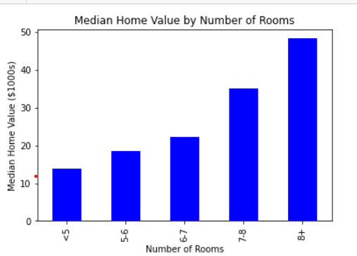
Examine the relationship between the number of rooms and the median value (MEDV) :
The plot depicts a positive relationship between the number of rooms in a house and the median home value. As the number of rooms increases, the median home value tends to rise, as indicated by the upward trend on the x-axis. Houses with 8 or more rooms exhibit the highest median home values. This emphasizes the significance of the number of rooms as a determining factor for the median home value.

Slide 15

Conclusion
Crime Rate Impact: There is a negative correlation between the per capita crime rate and the median value of owner-occupied homes. Higher crime rates are associated with lower home values.
Charles River Proximity: Houses located near the Charles River tend to have higher median home values compared to those farther away. This could be due to factors such as scenic location and access to amenities.
Property Characteristics: The number of rooms in a house has a positive impact on the median home value. As the number of rooms increases, the median home value tends to rise. Other factors like property age, accessibility to radial highways, and property tax rate also influence the median home value.
Relationships Among Variables: The dataset shows various relationships among variables, such as the impact of pollution on home values, the relationship between tax rates and median home values, and the influence of the pupil-teacher ratio on home values.

Slide 16


